Slide 1
Virtualization Using Docker Containers: For creating reproducible environments and containerized applications
IA 697 Starred paper proposal
Srinath Reddy Meadusani
Committee members
Dr. Susantha Herath, Chair
Dr. Ezzat Kirmani
Dr. Kasi Balasubramanian
Spring 2018
03/16/2018
Notes:
Add NSF logo

Slide 2
Contents
Problem Statement
Introduction
Docker Features
References

Slide 3
1. Problem Statement
In today’s competitive environment using the available resources efficiently has become imperative for IT organizations.
The traditional virtualization techniques which are being used in past years, has shown some degradation in the performance of applications which are deployed on those virtual machines.
Data center size of these organizations have also been increasing because of these obsolete virtualizations techniques.

Slide 4
2. Introduction
In the history of computing Containers have unique recognition because of its importance in virtualization of infrastructure.
Containers run the user space on top of the operating system kernel unlike traditional Hypervisor virtualization where one or more independent machines run virtually on physical hardware via an intermediate layer
Docker is an open-source engine which was introduced by Docker Inc in 2013 under apache 2.0 license to create light weight containers.

Slide 5
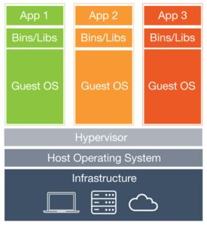
Continued…
Figure 1. Virtualization Using Virtual Machines (Wang, 2106)

Slide 6
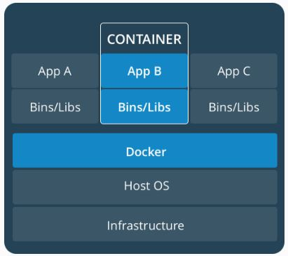
Continued…
Figure 3 Containerization using Dockers

Slide 7
Expected Outcomes
By the end of this study the paper answers the following questions:
Why there is a need for virtualization of infrastructure in an organization?
What are the problems with existing virtualization techniques?
Why there is a need to use containerized virtualization?
How did these containers solve the overheads of an organization?
How secure and compatible are these Containers?

Slide 8
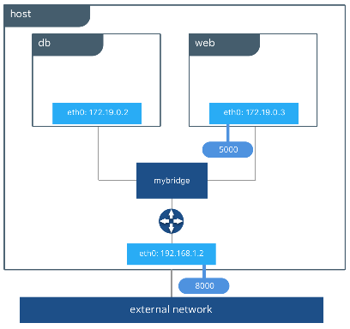
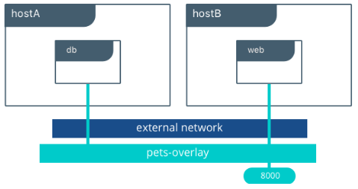
3. Docker Features
Networking: Bridge, Overlay, Host and Macvlan Networking drivers
Bridge Network
Overlay Network

Slide 9
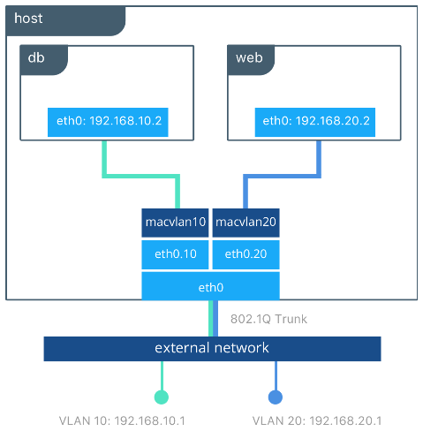
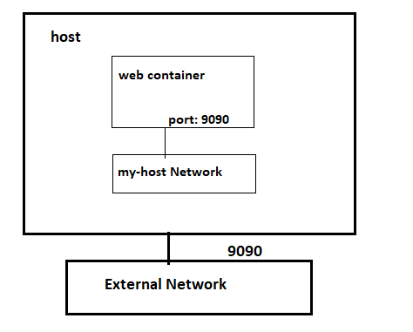
Networking Continued….
Host Network
Macvlan Network

Slide 10
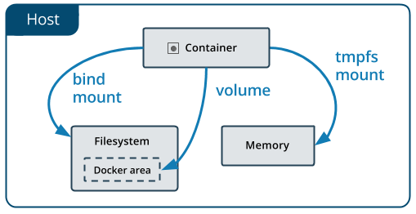
Docker Storage
Volumes, bind mounts and tmpfs to mount the data into the container from the host.
Containers Storage

Slide 11
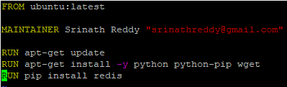
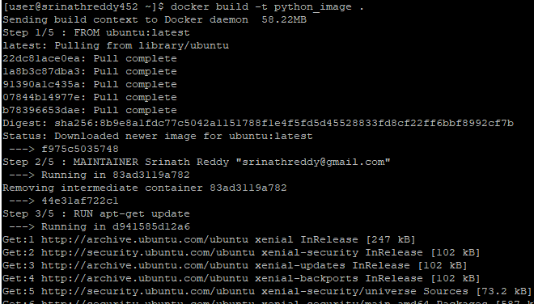
Dockerfile
Infrastructure as a code
Image Creation from Dockerfile

Slide 12
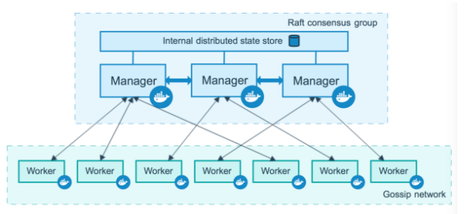
Docker Swarm
Orchestration System For Docker
Containerization in swarm mode

Slide 13
Docker Compose
Application needs more than one container which are isolated.
Useful in Dev and QA environments which reduces the overhead of maintaining and monitoring the infrastructure.
Docker-compose.yml contains the instructions which are written in YAML (Yet Another Markup Language or YAML Ain’t Markup Language) to spin up our Dev / QA environments

Slide 14
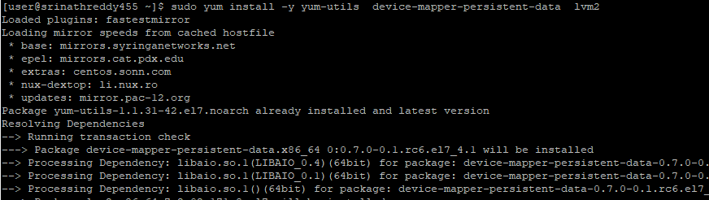
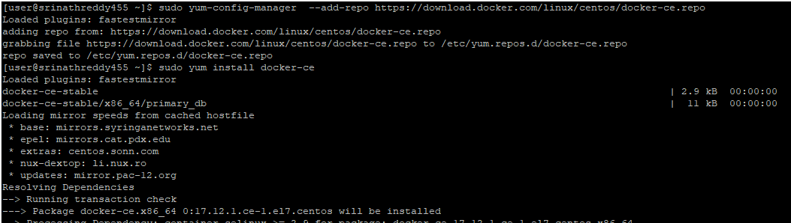
Setting Up the Environment
Install Docker Engine
Installing Docker Engine

Slide 15
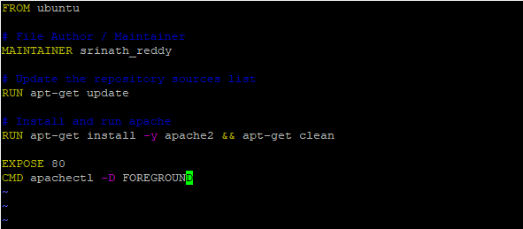
Continued…
Spinning up an apache-based web container and exposing it to outside world
Dockerfile for apache webserver

Slide 16
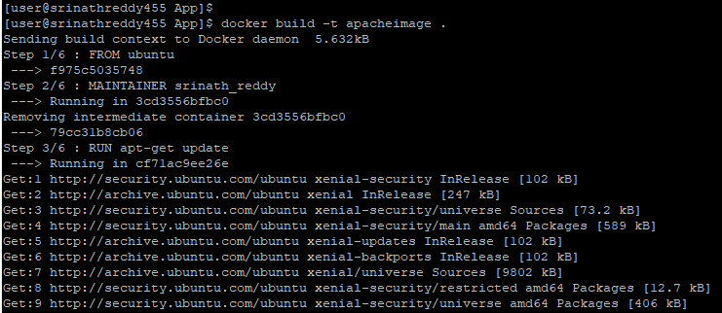
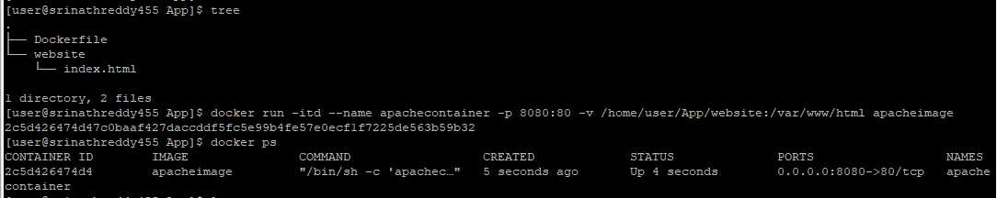
Continued…
Building the Apache Image from Dockerfile
Running the container out of Apache Image

Slide 17
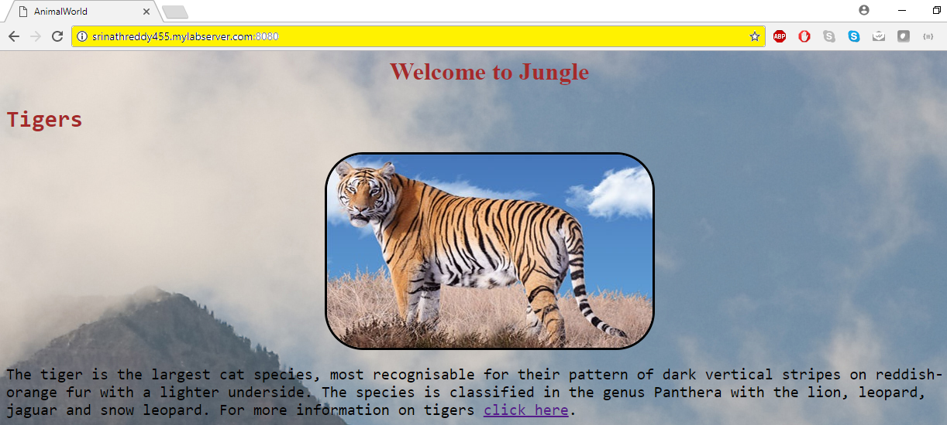
Continued…
Accessing the website using hostname

Slide 18
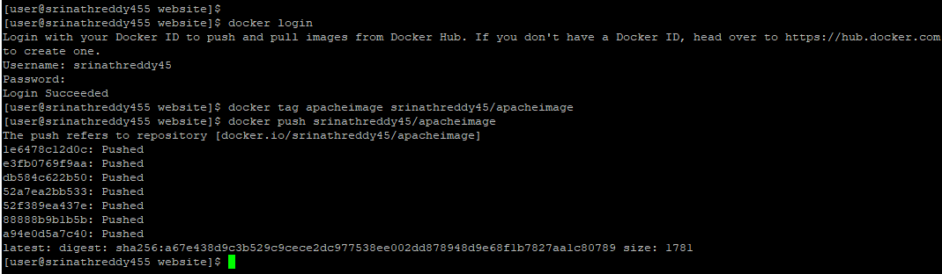
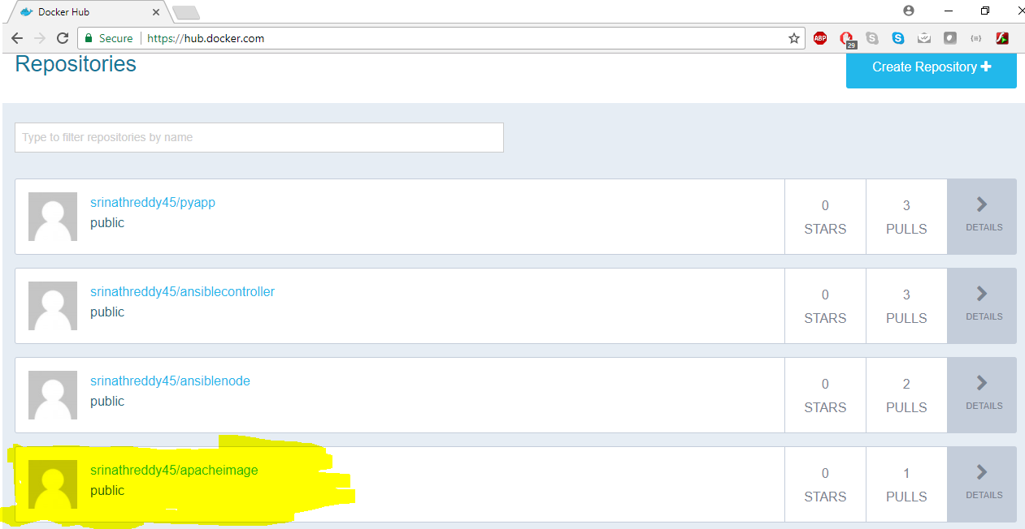
Continued…..
Pushing the image to Docker hub
Verifying the push on Docker hub

Slide 19
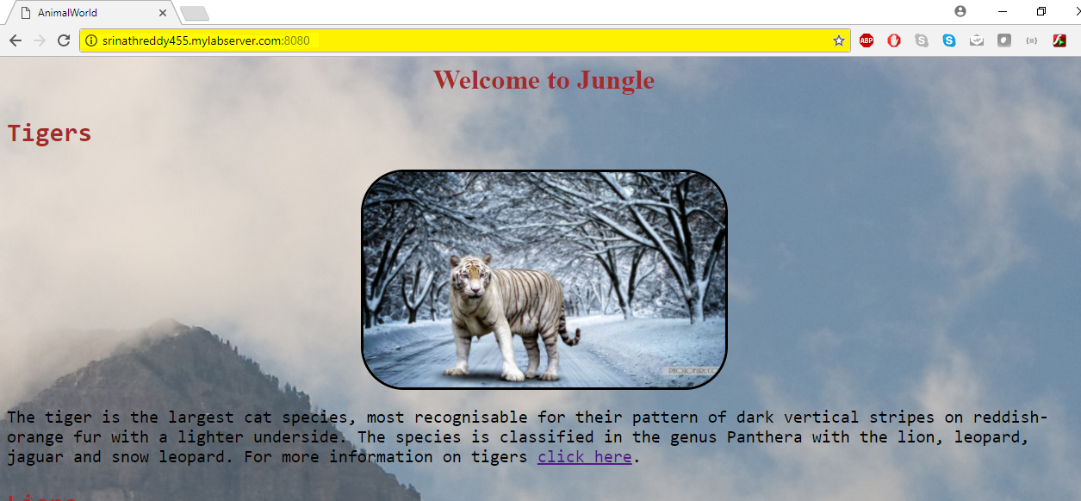
Continued….
Updated Web content

Slide 20
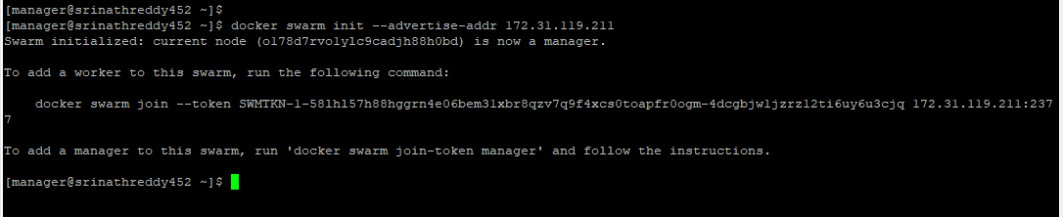
Scaling the website using Docker Swarm
Hostname | Role
srinathreddy452.mylabserver.com | Manager
srinathreddy453.mylabserver.com | Worker1
srinathreddy454.mylabserver.com | Worker2
Manager and Worker nodes
Initializing the swarm on manager node

Slide 21


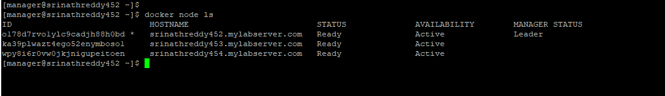
Continued……
Joining worker1 to Swarm
Joining worker2 to Swarm
Verifying nodes status

Slide 22
Continued……

Slide 23
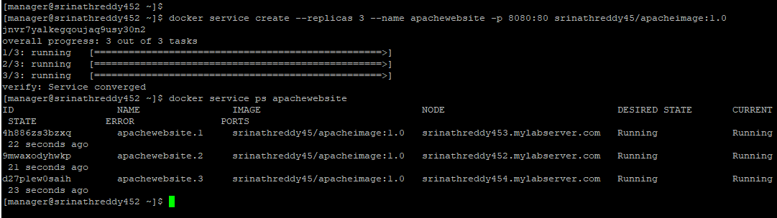
Continued……
Creating the service on our swarm

Slide 24
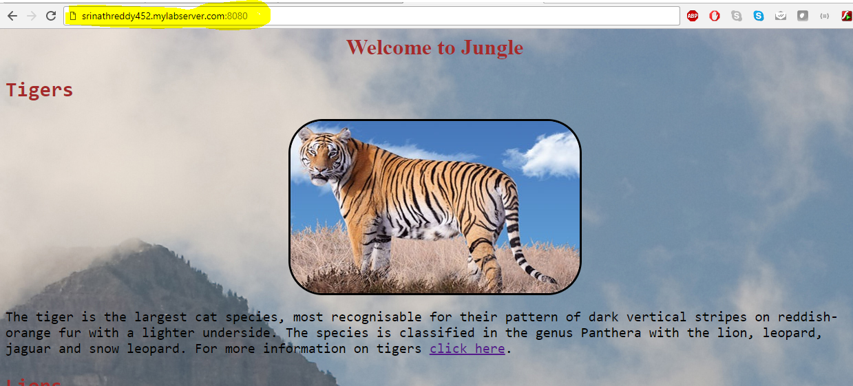
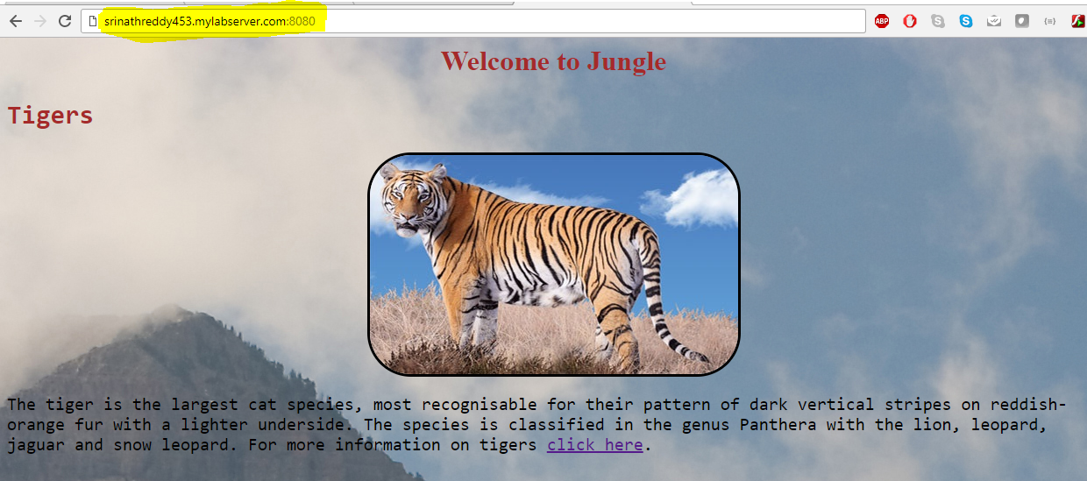
Continued……
Accessing the website using Manger node hostname
Accessing the website using worker1 node hostname

Slide 25
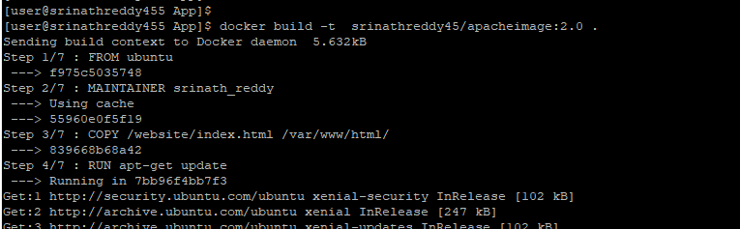
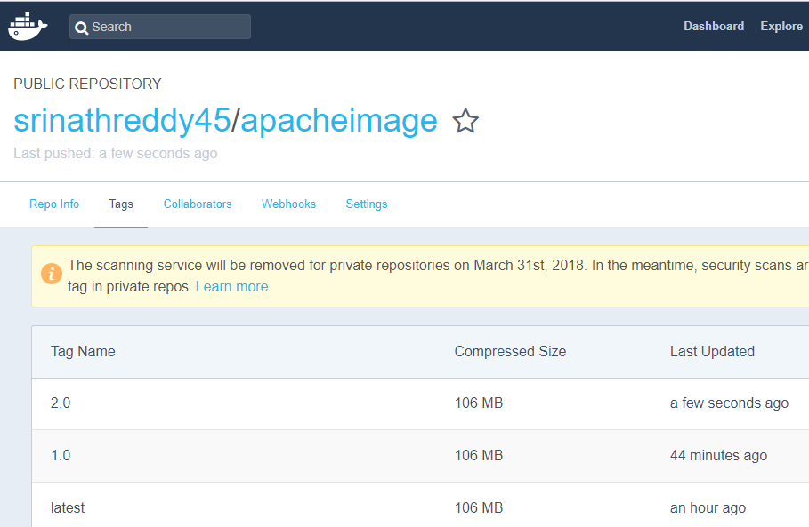
Updating the Content on Website
Building the updated image
Verifying the updated image on Docker hub

Slide 26
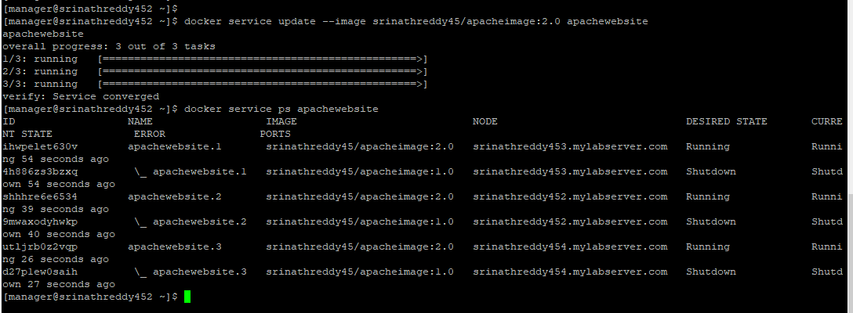
Continued……
Rolling update of image on all the containers

Slide 27
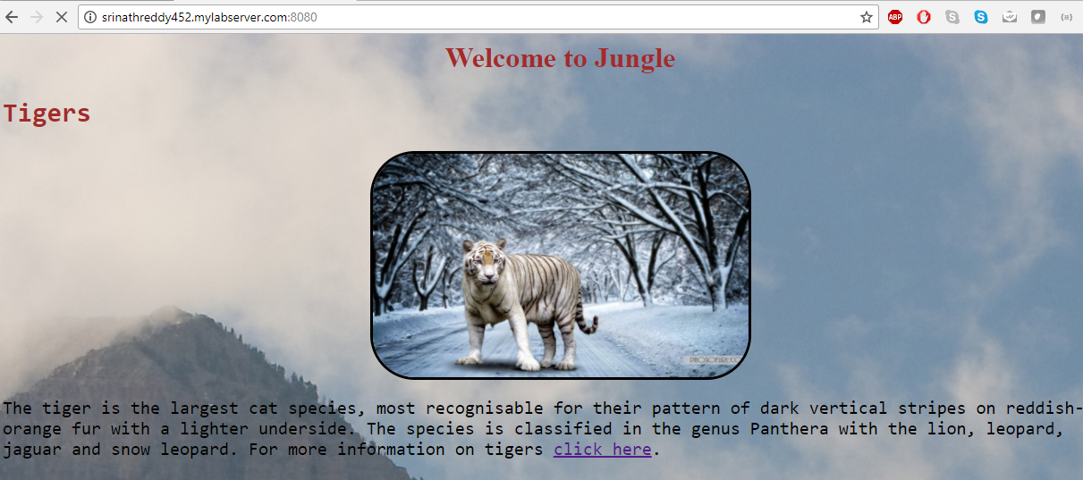

Continued……
Accessing the updated website using Manger node hostname
Accessing the updated website using worker2 node hostname

Slide 28
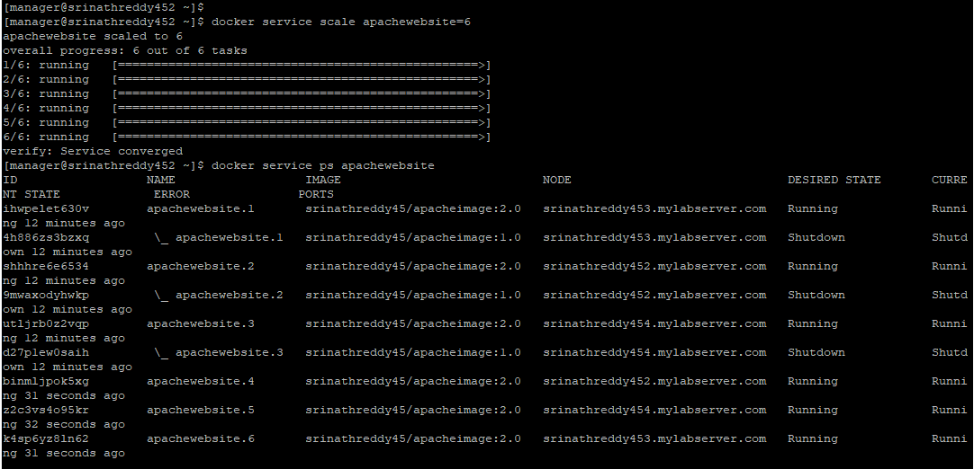
Continued……
Scaling the number of containers hosting our website

Slide 29
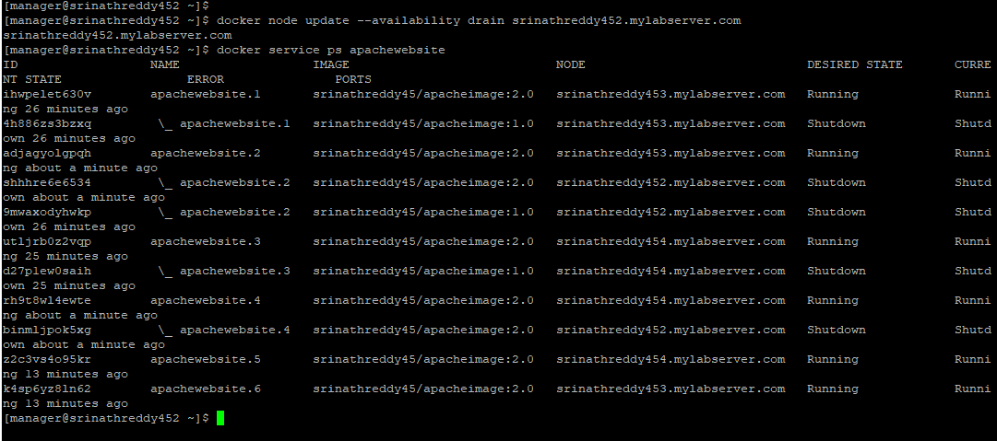

Continued……
Draining a node
Verifying nodes status

Slide 30
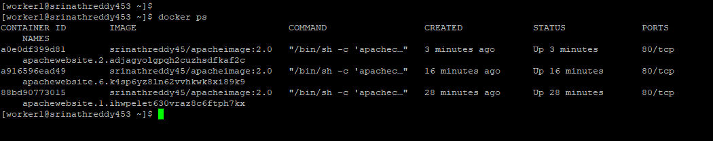
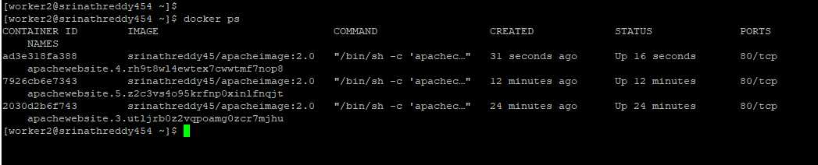
Continued……
Verifying capacity on worker1
Verifying capacity on worker2

Slide 31
Docker Security
Risk of privilege escalation is very high when using containers
Needs to careful while using images from public repositories
Denial of Service(DoS) attack, where one compromised container can seize the operability of other containers by denying the host system resources to other containers

Slide 32
Continued……

Slide 33
Continued……

Slide 34
Continued……

Slide 35
Continued……

Slide 36
Continued……

Slide 37
7. References
[1] Ryan Chamberlain, Jennifer Schommer: “Using Docker to Support Reproducible Research”, 2014.
[2] Chao Zheng, Douglas Thain: “Integrating containers into workflows: A case study using Makeflow, Work Queue and Docker”, 2015.
[3] Carl Boettiger: “An introduction to Docker Reproducible Research with Examples from R Environment”, 2014.
[4] Charles Anderson: “Dockers in Software Engineering”, 2015.
[5]
http://www.infoworld.com/article/3072929/linux/containers-101-linux-containers-and-docker-explained.html
[6] James Turnbull: “The Docker Book”, 2014.

Slide 38
References( Cont…)
[7] Shrikrishna Holla: “Orchestrating Docker: Manage and Deploy Docker services to containerize applications efficiently”, 2015.
[8]
https://www.sdxcentral.com/cloud/containers/definitions/what-are-containers-like-docker-linux-containers/
[9] LeVeque R, Mitchell I: “Reproducible Research for Scientific Computing: Tools and Strategies for Changing the Culture”, 2012.
[10] I. Altintas, C. Berkley: “An extensible system for design and execution of scientific workflows in Scientific and Statistical Database Management”, 2004.

Slide 39


Slide 40


